Slide 1
Python, Motion Sensors and Data Fusion PyCon UK, 15 September 2016
Stephen Simmons
mail@stevesimmons.com
https://github.com/stevesimmons/pyconuk-motion-sensor-data-fusion

Slide 2
Goals for today…
Why play with motion sensors?
tiny sensors + fun applications + cheap

Slide 3
Goals for today…
Why play with motion sensors?
tiny sensors + fun applications + cheap + smart algorithms in python

Slide 4
Goals for today…
Why play with motion sensors?
tiny sensors + fun applications + cheap + smart algorithms in python
Motion sensors then and now – 1852, 1965, 2016
Example #1 – Wireless motion logging with BBC micro:bit

Slide 5
Goals for today…
Why play with motion sensors?
tiny sensors + fun applications + cheap + smart algorithms in python
Motion sensors then and now – 1852, 1965, 2016
Example #1 – Wireless motion logging with BBC micro:bit
Data fusion – combining data from multiple sensors
Example #2 – micro:bit digital compass
Example #3 – full position tracking from mobile phone data

Slide 6
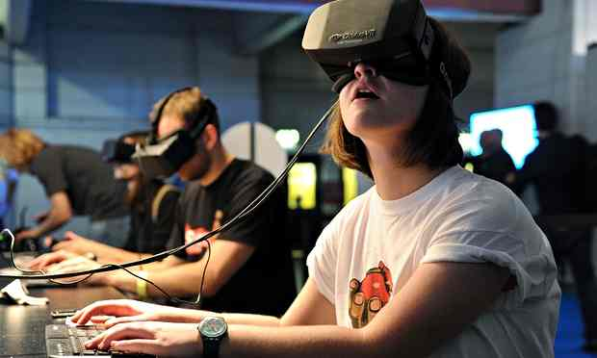
VR…

Slide 7
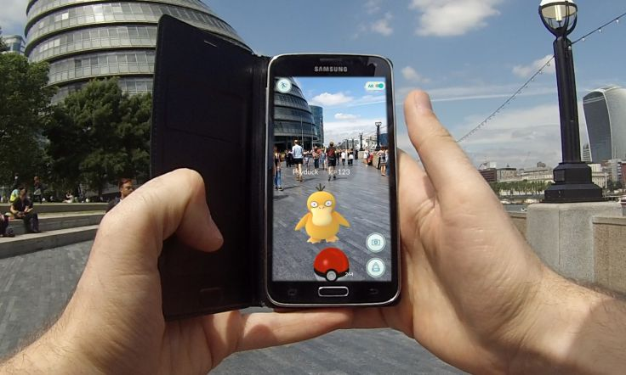
AR…

Slide 8
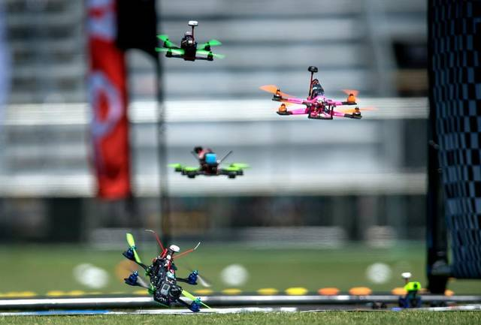
Navigation and control…

Slide 9
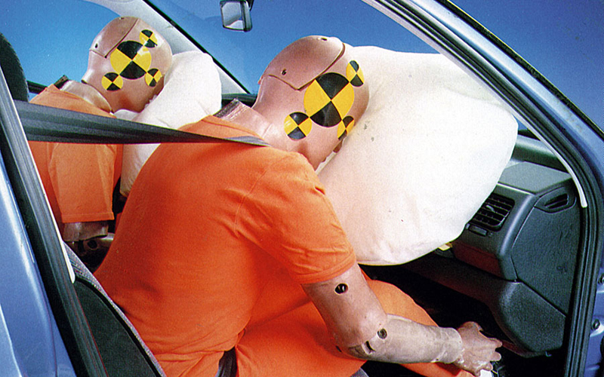
Automotive…

Slide 10
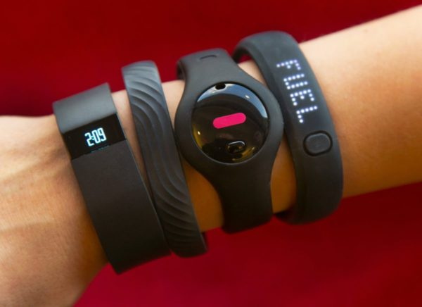
“Quantified self”…

Slide 11
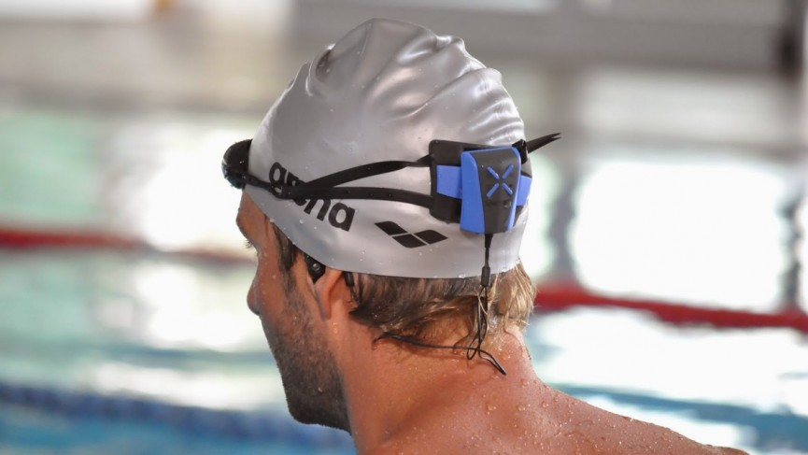
Sports…

Slide 12
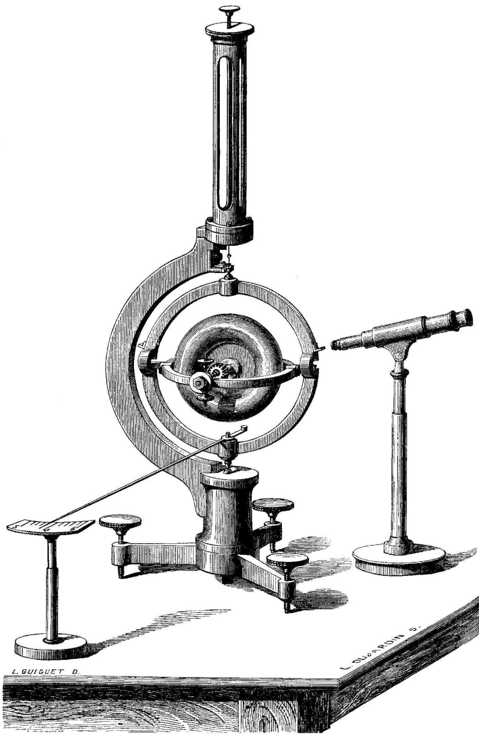
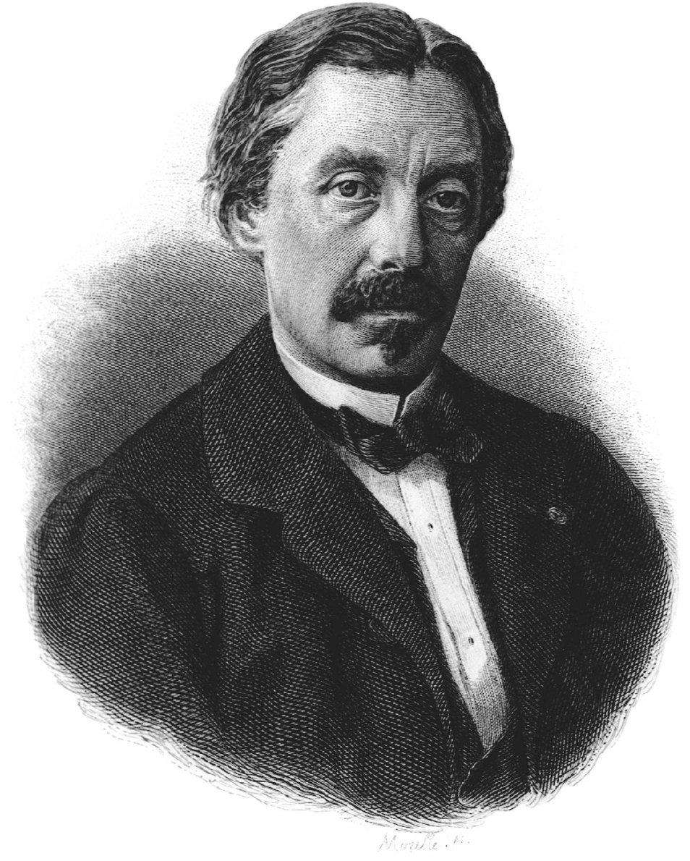
Sensors in 1862 – Foucault’s gyroscope
Notes:
In 1851, Leon Foucault famous pendulum rotated once per sidereal day – 23h56m at the poles.
But as you move down in latitude, the swing plane is at an angle to the rotation of the earth through the poles.
The rotation slowed down depending on the sine of the latitude.
In 1852, he build a gyroscope where the rotating mass maintained a fixed direction as the earth rotated.
It only ran for 10 minutes before slowing. This was enough to prove the principle.
Pictures are from http://tobin.pagesperso-orange.fr/PROBING_SPACE_Nelson.pdf

Slide 13
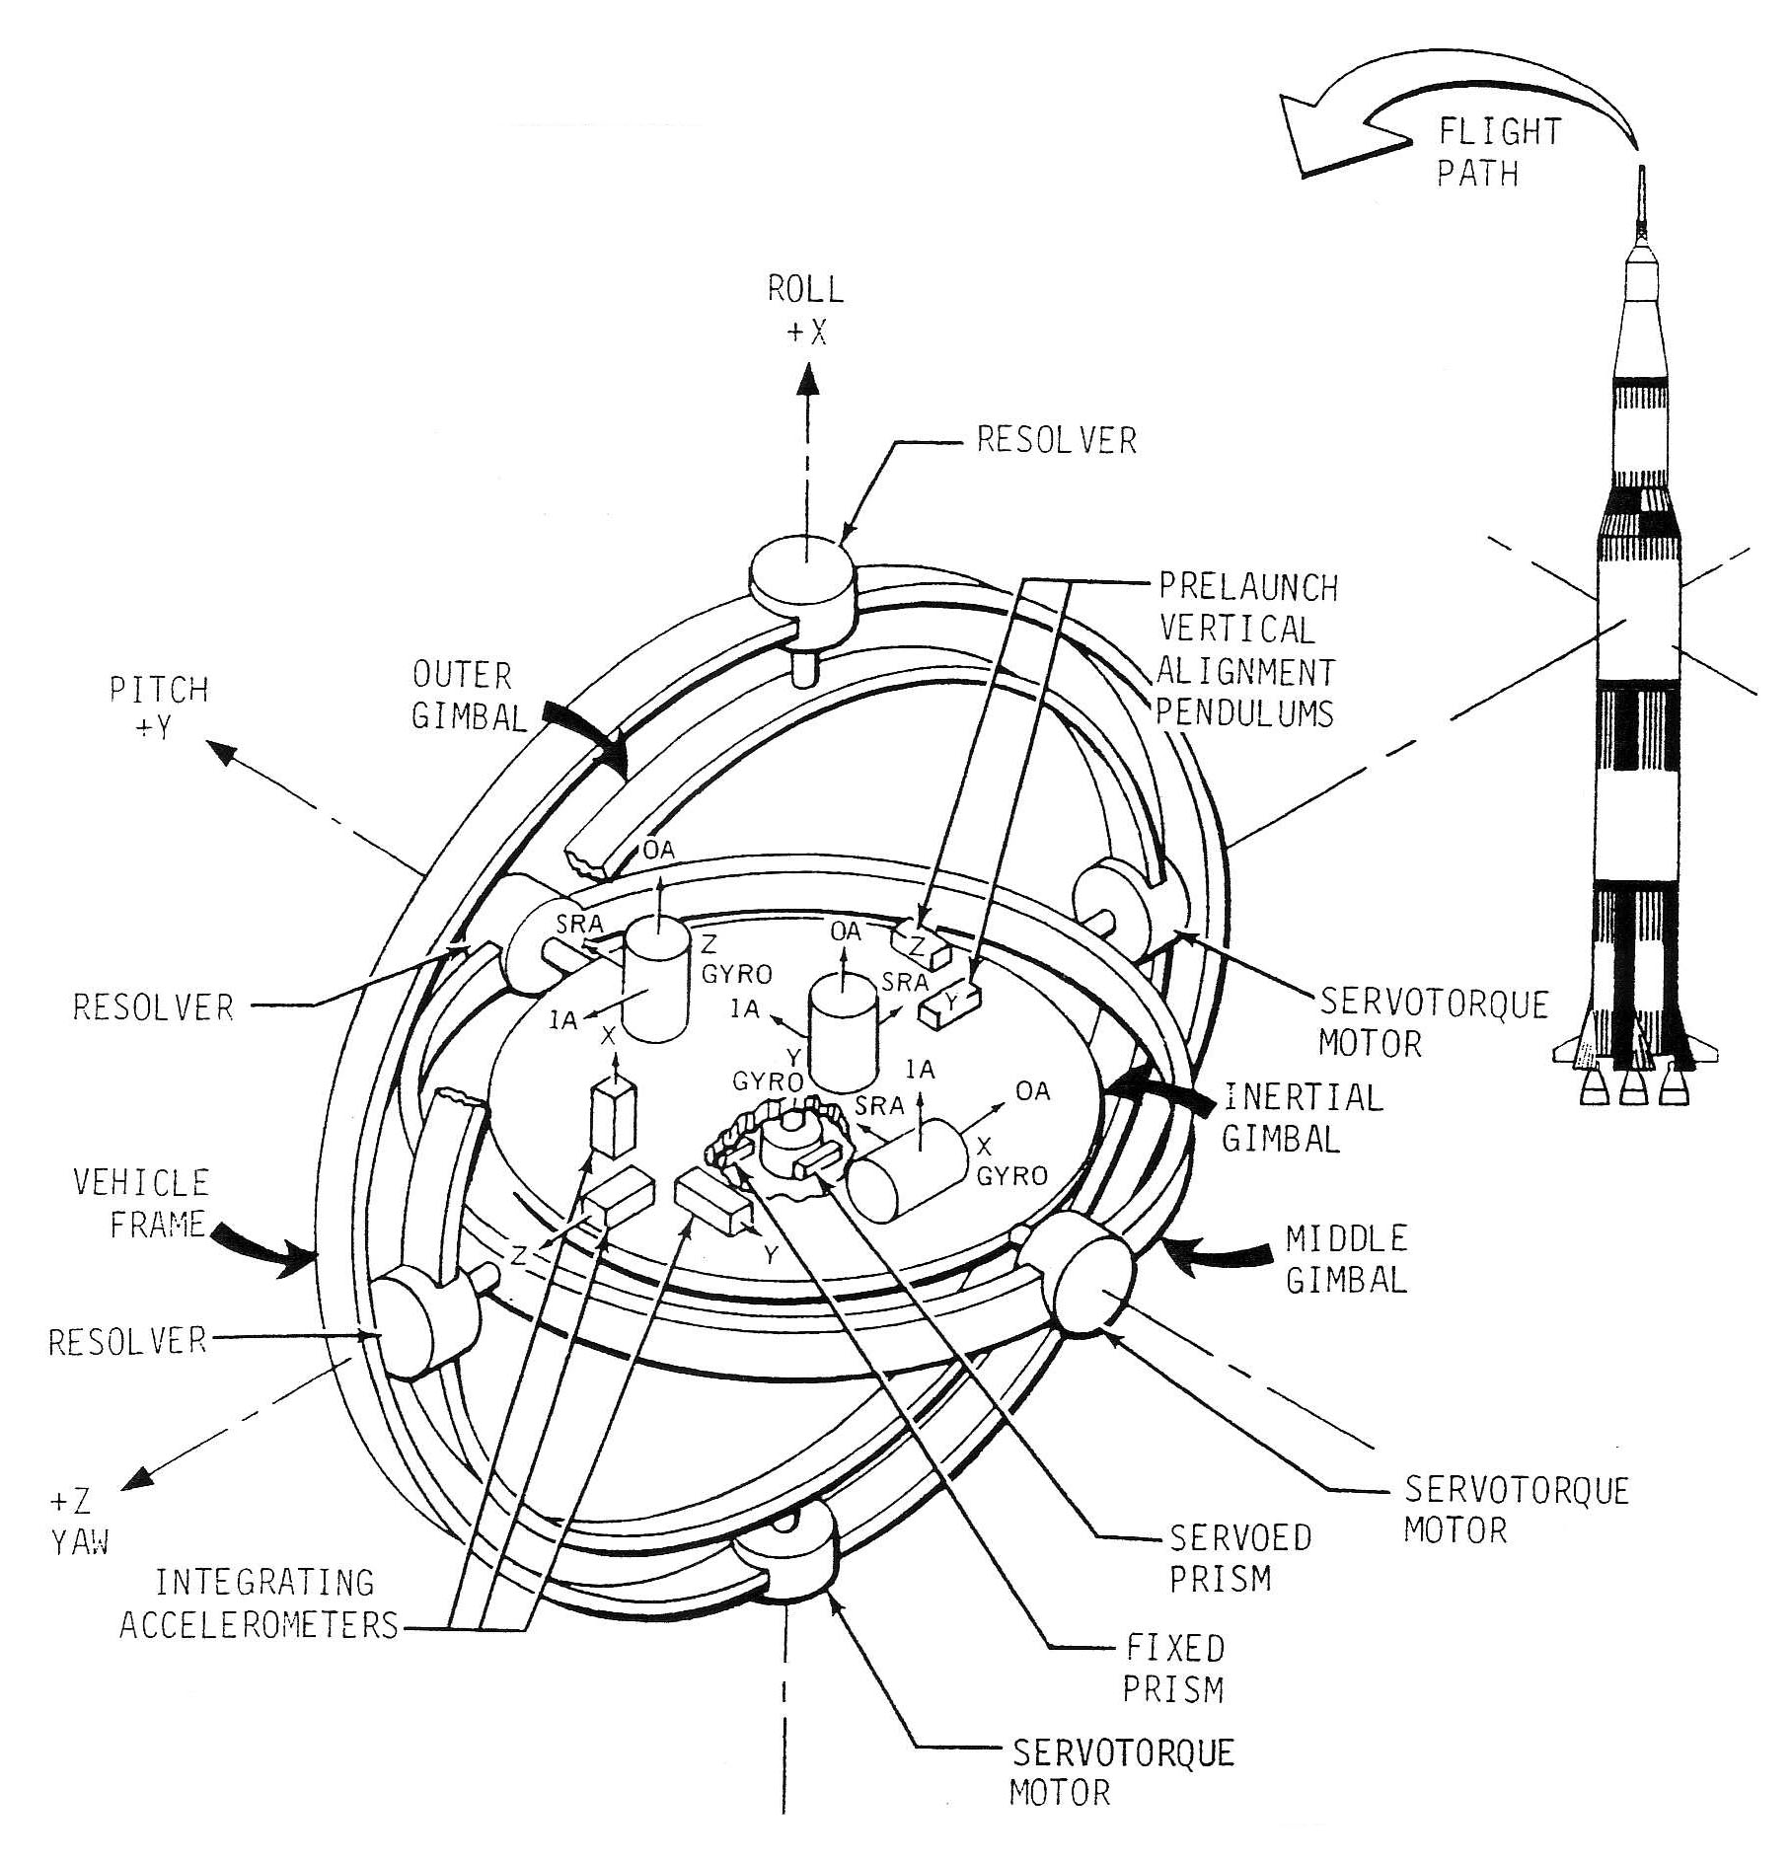
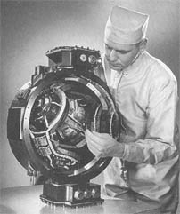
Sensors in 1965 – ST124-M inertial platform
Notes:
ST124-M inertial platform system

Slide 14
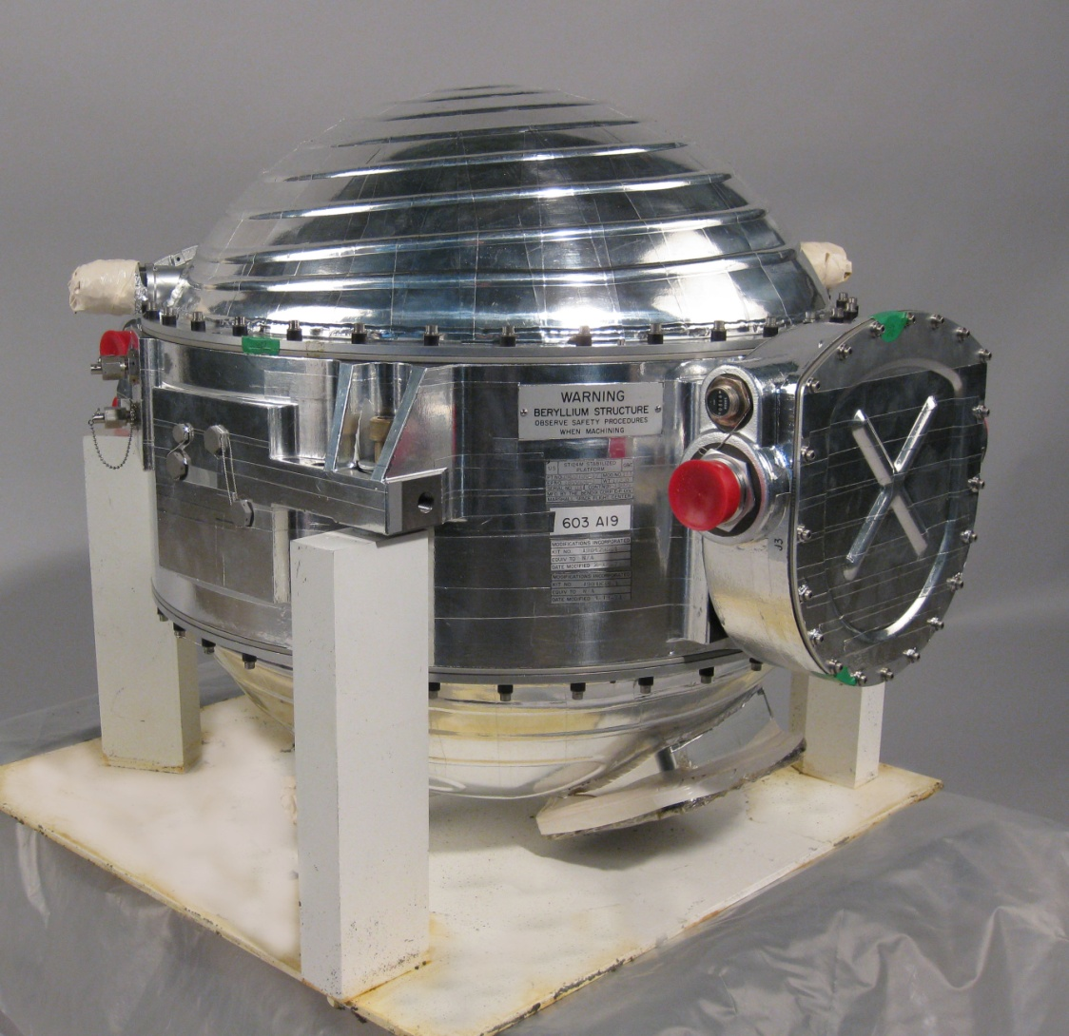

Slide 15
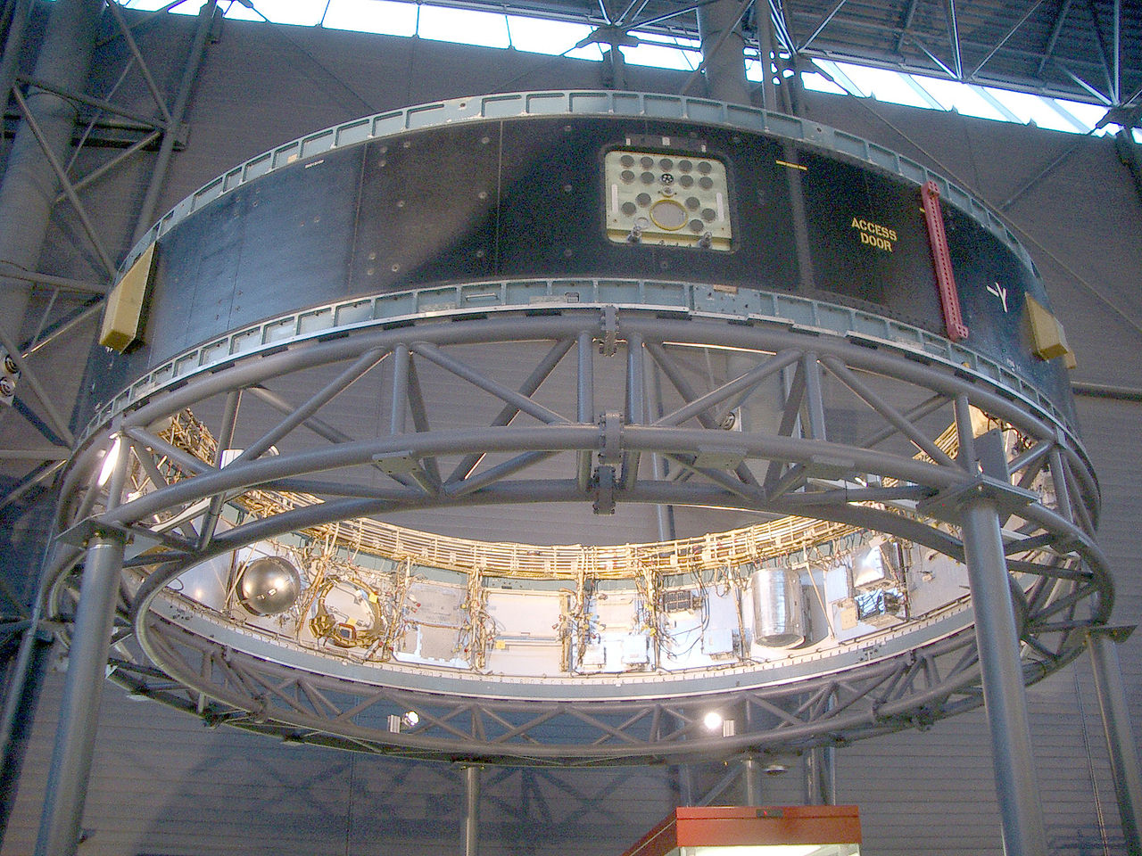
Notes:
IU-514 instrument unit
Silver sphere contains nitrogen for lubricating the gimbals.
Empty spot to the right is where the ST124-M gimbal unit would sit

Slide 16
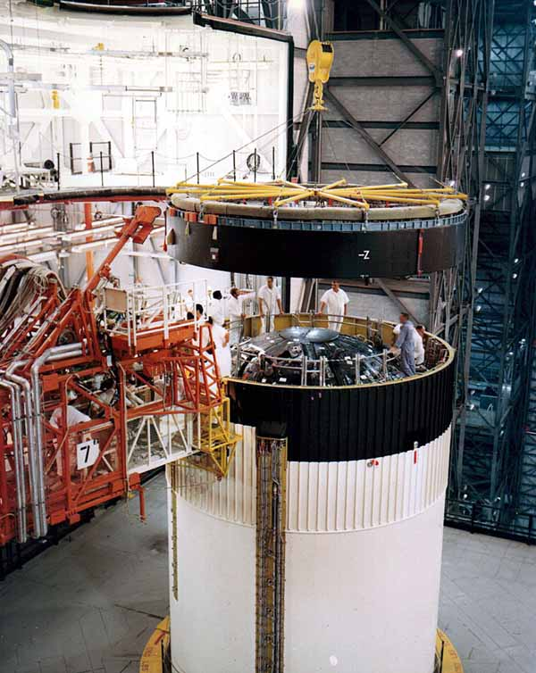

Slide 17
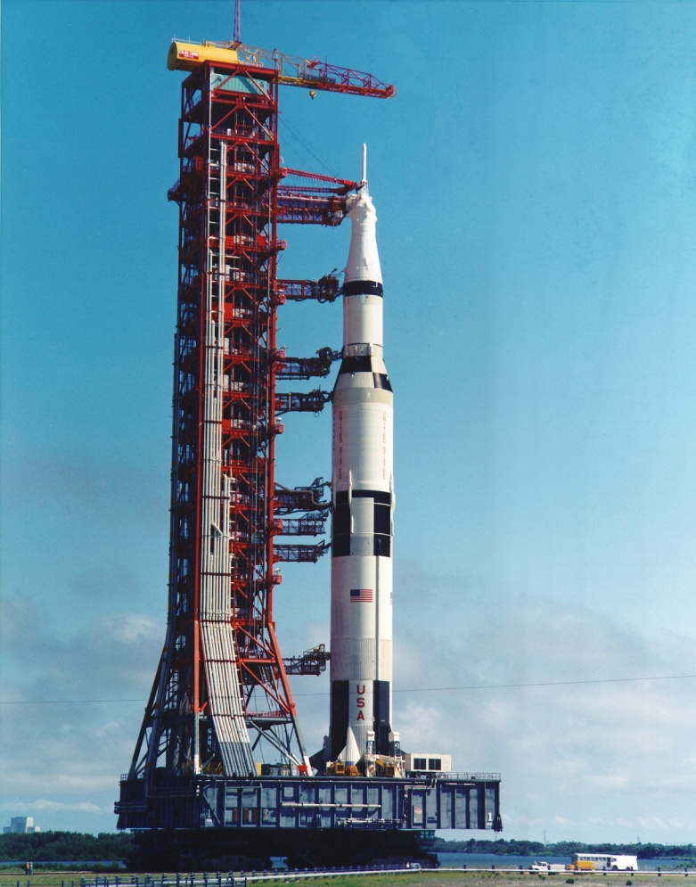

Slide 18
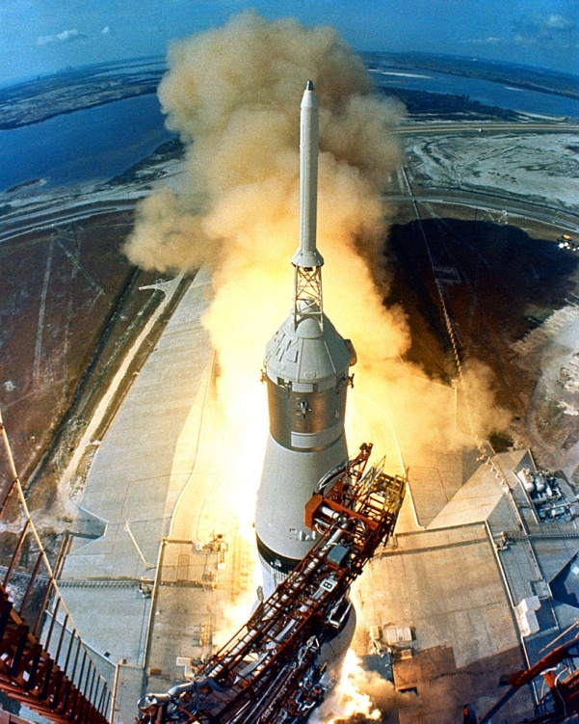

Slide 19
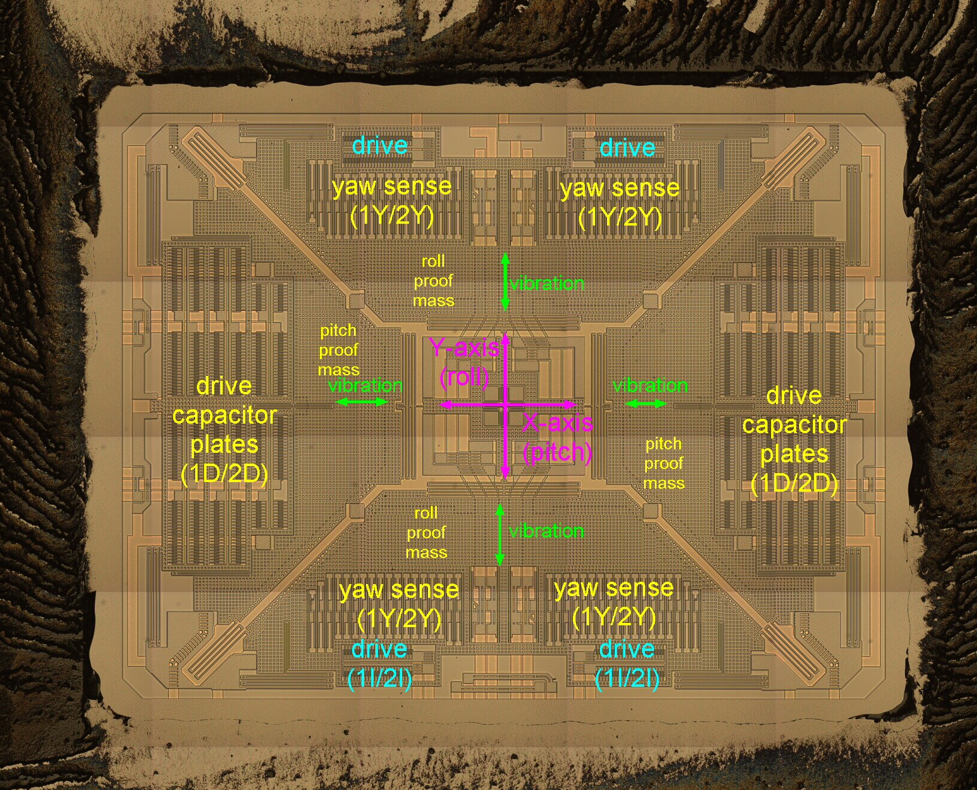
Sensors in 2016 – MEMS gyroscope
Notes:
MEMS = Micromachined electromagnetic structure

Slide 20
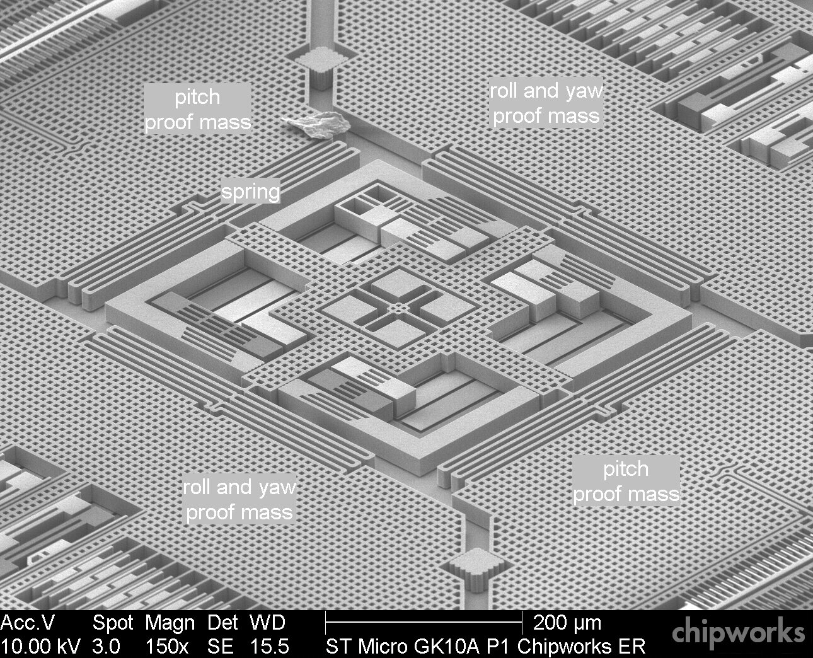
Sensors in 2016 – MEMS gyroscope
Notes:
Image is from:
http://www.memsjournal.com/2011/01/motion-sensing-in-the-iphone-4-mems-gyroscope.html
http://memsjournal.typepad.com/.a/6a00d8345225f869e20148c7d54d63970c-pi

Slide 21
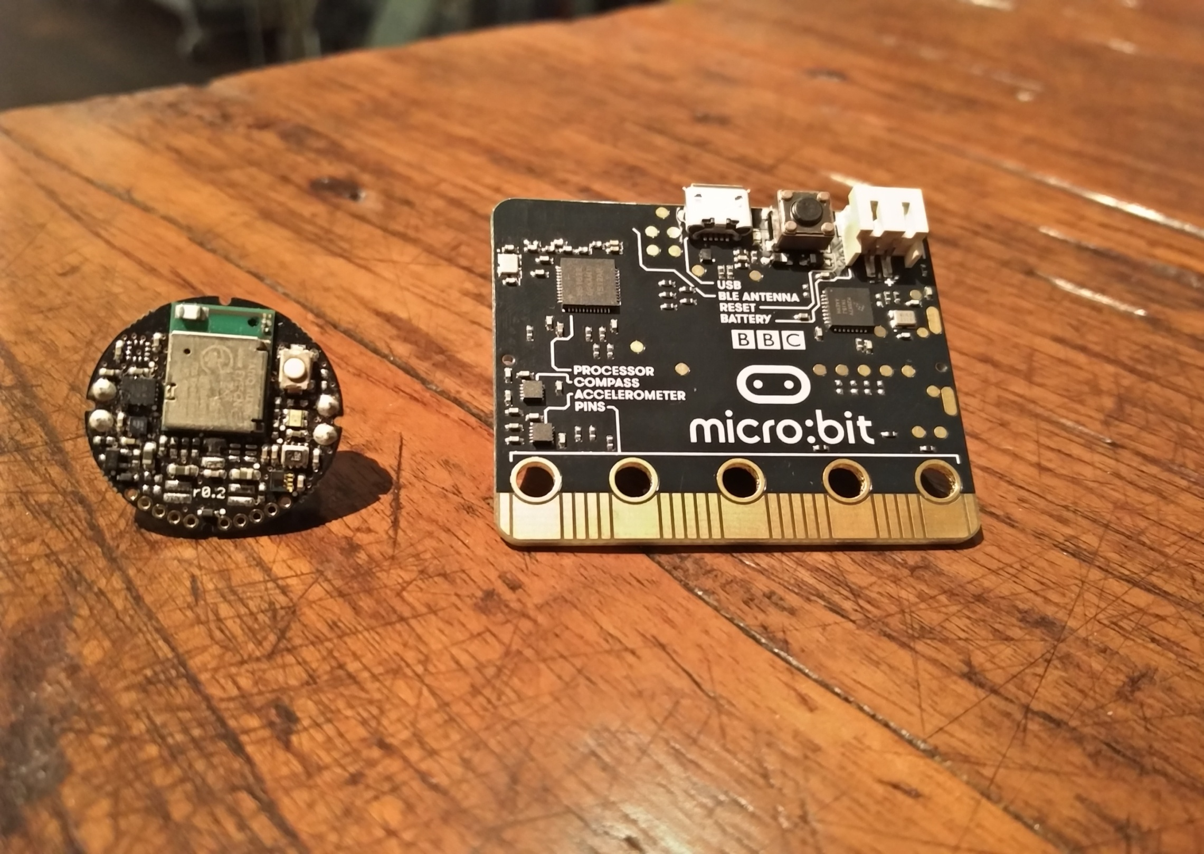
Sensors in 2016 – Metawear C and micro:bit
Notes:
MetaWear Pro C from Mbient Labs (24 mm diameter). BBC MicroBit (43x52mm)

Slide 22
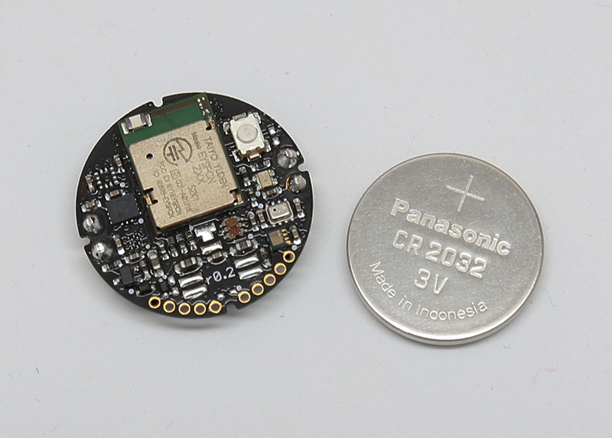
Metaware C Pro – hardware
[To be updated … These are Micro:Bit specs]
CPU
nRF51822 - Nordic Semiconductor
ARM Cortex-M0, 16k RAM, 256k flash
Interfaces
Bluetooth LE; radio; USB; push buttons
Sensors
Accelerometer MMA8652FC (NXP)
3 axis, 12-bit, up to 800Hz
6-180µA @ 2.4V
±2/4/8g (sens ±2.5%, offset ±33mg, noise 182µg/√Hz)
Magnetometer MAG3110 (NXP)
3 axis, 16-bit, up to 80 Hz
9-900µA @ 2.4V
±1000µT (sens 0.1µT, noise 0.25µT)
PCB: 24 mm diameter
sensors: 2 x 2 mm

Slide 23
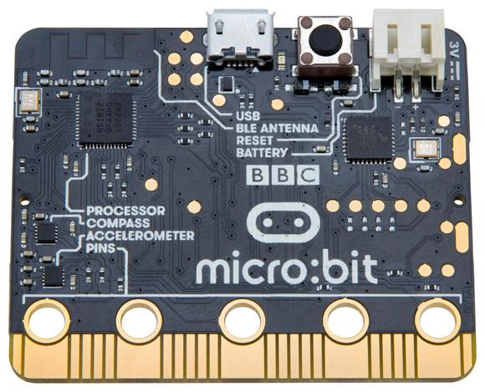
BBC microbit – hardware
CPU
nRF51822 - Nordic Semiconductor
ARM Cortex-M0, 16k RAM, 256k flash
Interfaces
Bluetooth LE; radio; USB; push buttons
Sensors
Accelerometer MMA8652FC (NXP)
3 axis, 12-bit, up to 800Hz
6-180µA @ 2.4V
±2/4/8g (sens ±2.5%, offset ±33mg, noise 182µg/√Hz)
Magnetometer MAG3110 (NXP)
3 axis, 16-bit, up to 80 Hz
9-900µA @ 2.4V
±1000µT (sens 0.1µT, noise 0.25µT)
PCB: 43 x 52 mm
sensors: 2 x 2 mm

Slide 24
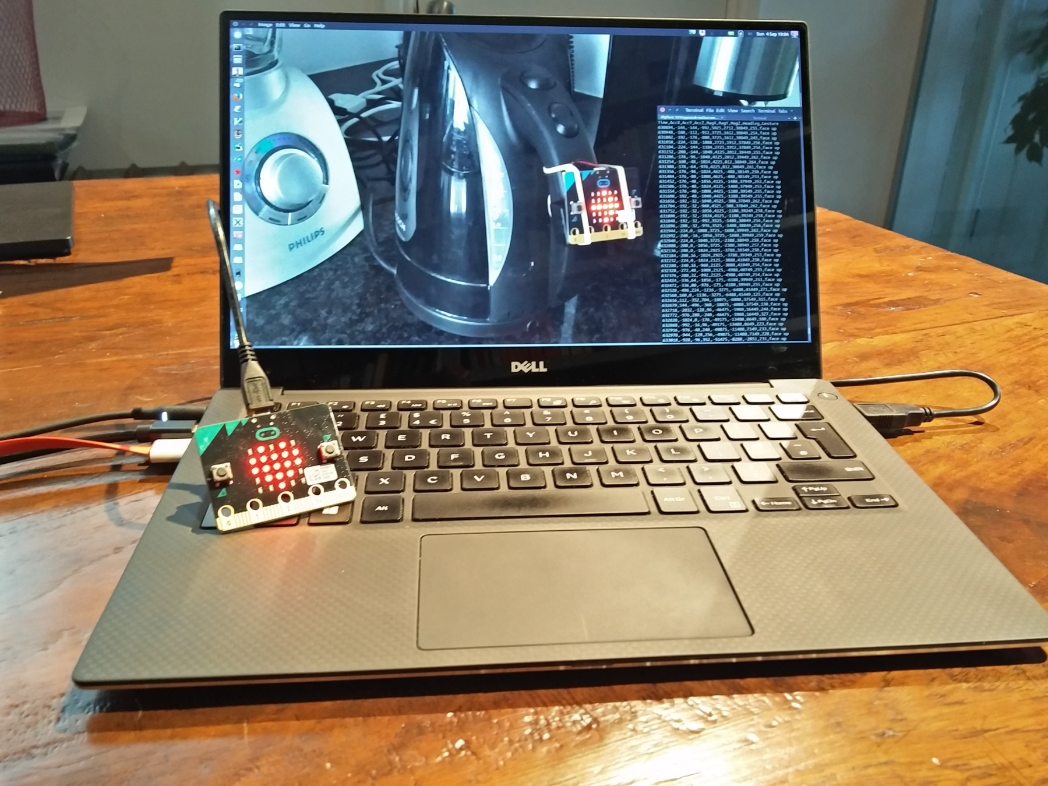
Example #1 – Wireless motion logging

Slide 25
Example #1 – BBC microbit code
# Transmit sensor data via radio
from microbit import *
import radio
header = "Time,AccX,AccY,AccZ,MagX,MagY,MagZ,Heading,Gesture\n“
def read_sensors():
"Sensor data as a comma-separated string with a newline"
t = running_time()
ax, ay, az = accelerometer.get_values()
g = accelerometer.current_gesture()
cx, cy, cz = compass.get_x(), compass.get_y(), compass.get_z()
h = compass.heading()
msg = '%d,%d,%d,%d,%d,%d,%d,%d,%s\n' % (t,ax,ay,az,cx,cy,cz,h,g)
return msg

Slide 26
Example #1 – BBC microbit code
# Transmit sensor data via radio
from microbit import *
import radio
header = "Time,AccX,AccY,AccZ,MagX,MagY,MagZ,Heading,Gesture\n“
def read_sensors():
"Sensor data as a comma-separated string with a newline"
t = running_time()
ax, ay, az = accelerometer.get_values()
g = accelerometer.current_gesture()
cx, cy, cz = compass.get_x(), compass.get_y(), compass.get_z()
h = compass.heading()
msg = '%d,%d,%d,%d,%d,%d,%d,%d,%s\n' % (t,ax,ay,az,cx,cy,cz,h,g)
return msg
radio.config(length=100)
radio.on()
radio.send(header)
while True:
data = read_sensors()
radio.send(data)
sleep(25)

Slide 27
Example #1 – BBC microbit code
# Transmit sensor data via radio
from microbit import *
import radio
header = "Time,AccX,AccY,AccZ,MagX,MagY,MagZ,Heading,Gesture\n“
def read_sensors():
"Sensor data as a comma-separated string with a newline"
t = running_time()
ax, ay, az = accelerometer.get_values()
g = accelerometer.current_gesture()
cx, cy, cz = compass.get_x(), compass.get_y(), compass.get_z()
h = compass.heading()
msg = '%d,%d,%d,%d,%d,%d,%d,%d,%s\n' % (t,ax,ay,az,cx,cy,cz,h,g)
return msg
radio.config(length=100)
radio.on()
radio.send(header)
while True:
data = read_sensors()
radio.send(data)
sleep(25)
# Relay radio data to host PC via USB
from microbit import *
import radio
radio.config(length=100)
radio.on()
uart.init(115000)
while True:
data = radio.receive()
if data:
uart.write(data)

Slide 28
Example #1 – Analyse data in IPython
# See Jupyter notebook analysis-kettle.ipynb
%matplotlib inline
import matplotlib
import pandas as pd
>>> df = pd.read_csv('data.csv')
>>> df['Time'] /= 1000.0 # ms to sec
>>> df.set_index('Time', inplace=True)
>>> df.info()
<class 'pandas.core.frame.DataFrame'>
Float64Index: 5860 entries, 12.9 to 246.1
Data columns (total 8 columns):
AccX 5860 non-null int64
AccY 5860 non-null int64
AccZ 5860 non-null int64
MagX 5860 non-null int64
MagY 5860 non-null int64
MagZ 5860 non-null int64
Heading 5860 non-null int64
Gesture 3760 non-null object
dtypes: int64(7), object(1)
memory usage: 412.0+ KB

Slide 29
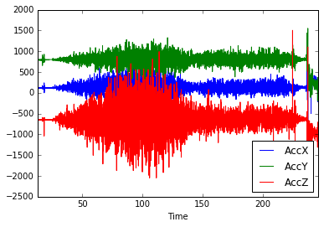
Example #1 – Analyse data in IPython
# See Jupyter notebook analysis-kettle.ipynb
%matplotlib inline
import matplotlib
import pandas as pd
>>> df = pd.read_csv('data.csv')
>>> df['Time'] /= 1000.0 # ms to sec
>>> df.set_index('Time', inplace=True)
>>> df.info()
>>> accXYZ = df[['AccX','AccY','AccZ']]
>>> accXYZ.plot()
heating
simmering
boiling

Slide 30
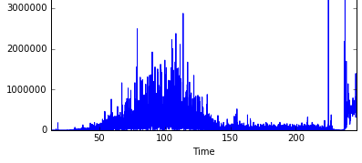
Example #1 – Analyse data in IPython
# See Jupyter notebook analysis-kettle.ipynb
%matplotlib inline
import matplotlib
import pandas as pd
>>> df = pd.read_csv('data.csv')
>>> df['Time'] /= 1000.0 # ms to sec
>>> df.set_index('Time', inplace=True)
>>> df.info()
>>> accXYZ = df[['AccX','AccY','AccZ']]
>>> accXYZ.plot()
>>> g = accXYZ[50.0:200.0].mean()
>>> g
AccX 128.733753
AccY 802.477987
AccZ -636.926625
dtype: float64
>>> s = (accXYZ - g).pow(2).sum(axis=1)
>>> s.plot()
heating
simmering
boiling

Slide 31
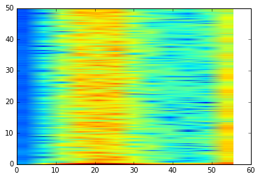
Example #1 – Analyse data in IPython
# See Jupyter notebook analysis-kettle.ipynb
%matplotlib inline
import matplotlib
import pandas as pd
>>> df = pd.read_csv('data.csv')
>>> df['Time'] /= 1000.0 # ms to sec
>>> df.set_index('Time', inplace=True)
>>> df.info()
>>> accXYZ = df[['AccX','AccY','AccZ']]
>>> accXYZ.plot()
>>> g = accXYZ[50.0:200.0].mean()
>>> g
AccX 128.733753
AccY 802.477987
AccZ -636.926625
dtype: float64
>>> s = (accXYZ - g).pow(2).sum(axis=1)
>>> s.plot()
>>> import matplotlib.pyplot as plt
>>> plt.specgram(s, NFFT=512, Fs=100, noverlap=32)[3]
heating
simmering
boiling

Slide 32
More sensors == many more options

Slide 33
References
Github report accompanying this talk
http://github.com/stevesimmons/pyconuk-motion-sensor-data-fusion
BBC micro:bit (has accelerometer and magnetomer, no gyroscope)
MicroPython http://microbit-micropython.readthedocs.io
Mu editor / uFlash https://github.com/ntoll/mu http://uflash.readthedocs.org
MMA8652 accelerometer http://www.nxp.com/files/sensors/doc/data_sheet/MMA8652FC.pdf
MAG3110 magnetometer http://www.nxp.com/files/sensors/doc/data_sheet/MAG3110.pdf
http://www.nxp.com/files/sensors/doc/data_sheet/AN4083.pdf
Data fusion concepts
NXP sensor fusion toolbox (version 7.00, 18 August 2016)
http://www.nxp.com/products/sensors/nxp-sensor-fusion:XTRSICSNSTLBOX?tid=vansensorfusion
Datasheet http://cache.nxp.com/files/sensors/doc/data_sheet/XSFLK_DS.pdf
User guide http://cache.nxp.com/files/sensors/doc/user_guide/NSFK_Prod_UG.pdf
Electronic compass projects (accelerometer and magnetometer)
Circuit Cellar (2012) http://cache.nxp.com/files/sensors/doc/reports_presentations/ARTICLE_REPRINT.pdf
IMU/AHRS projects (accelerometer, gyroscope, magnetometer)
Madgwick’s algorithm (2010) https://www.samba.org/tridge/UAV/madgwick_internal_report.pdf
IMU Data Fusing http://www.olliw.eu/2013/imu-data-fusing/
9DoF Sensor Fusion https://github.com/kriswiner/MPU-6050/wiki/Affordable-9-DoF-Sensor-Fusion
Experimental Comparison of Sensor Fusion Algorithms for Attitude Estimation (A Cavallo et al IFAC 2014) http://www.nt.ntnu.no/users/skoge/prost/proceedings/ifac2014/media/files/1173.pdf
BerryIMU http://ozzmaker.com/berryimu-quick-start-guide https://github.com/mwilliams03/BerryIMU
MicroPython 6/9-DOF fusion (needs gyro -> not for BBC micro:bit) https://github.com/micropython-IMU/micropython-fusion

Slide 34
They use comparable MEMS sensors
 | Phone OnePlus2 | Wearable MetaWear C PRO | Board BBC Micro:bit
Accelerometer | LIS3DSH (STM) | BMI160 IMU (Bosch) | MMA8652 (NXP Freescale)
Gyroscope | L3D20 (STM) |  | -
Magnetometer | MMC34160PJ (MEMSIC) |  | MAG3110 (NXP Freescale)
Source | My Sensors Android app
RF | Wifi, BT, BLE | BLE | BLE, radio
Memory |  |  | 16k RAM, 256k flash

Slide 35
In technical terms, what do we want?
Real-time measurement of speed, orientation, position, …
Cheap, low-power sensors
Low-latency algorithms to clean up/pre-process raw data
Sensor-fusion – merge
High-level outputs – gestures, triggers

Slide 36
Sensor degrees of freedom
6 DOF = 3-axis gyroscope and accelerometer = IMU
9 DOF = IMU + compass (magnetometer)
10 DOF = adds barometer (pressure)
11 DOF = add GPS receiver

